Slide 1
KubespraY + vagrant + ansible MSA 환경 자동 배포

Slide 2
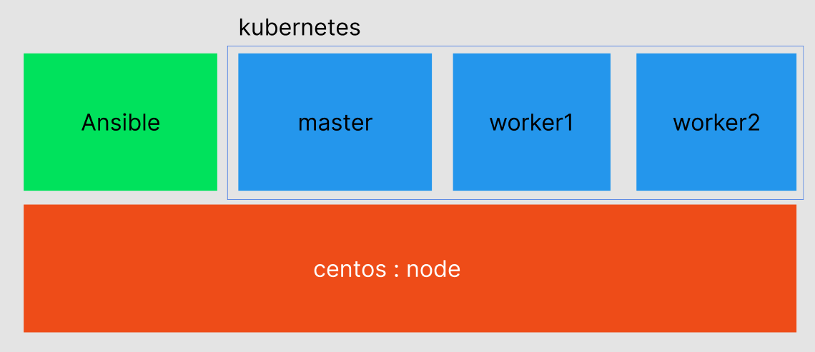

Slide 3
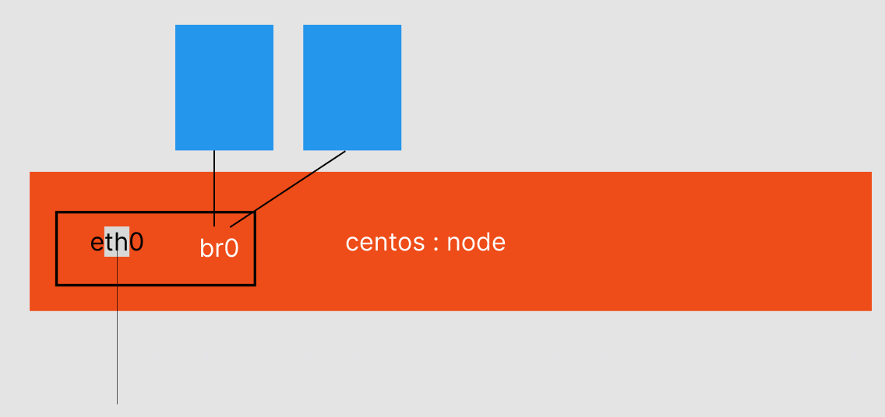

Slide 4
# 저장소와 인증키 가지고 오기
rpm --import https://www.elrepo.org/RPM-GPG-KEY-elrepo.org
yum install -y https://www.elrepo.org/elrepo-release-7.el7.elrepo.noarch.rpm
# 실재 커널 설치
sudo yum --enablerepo=elrepo-kernel install -y kernel-lt
# 실재 커널의 추가적인 라이브러리 설치
sudo yum --enablerepo=elrepo-kernel install -y kernel-lt-{devel,headers,perf}
# 내용 수정
vi /etc/default/grub
# 설치된 커널 버전들을 볼 수 있다.
sudo grub2-mkconfig -o /boot/grub2/grub.cfg
grep ^menuentry /boot/grub2/grub.cfg | cut -d "'" -f2
# CentOS 5.4로 고정해준다 - 나는 5.4.196이 설치되어 있어서 이걸로 해주었다.
grub2-set-default "CentOS Linux (5.4.196-1.el7.elrepo.x86_64) 7 (Core)"

Slide 5
yum -y install libguestfs libguestfs-utils libvirt qemu-kvm virt-install virt-manager virt-viewer
# 패키지 설치
yum-config-manager --add-repo https://rpm.releases.hashicorp.com/RHEL/hashicorp.repo
yum -y install libvirt-daemon-kvm libvirt-client vagrant gcc-c++ make libstdc++-devel libvirt-devel
# libvirtd와 vagrant 실행
systemctl restart libvirtd
vagrant plugin install vagrant-libvirt
vagrant -v

Slide 6
$ sudo parted /dev/sda GNU Parted 3.1 Using /dev/sda Welcome to GNU Parted! Type 'help' to view a list of commands. (parted) p Model: ATA VBOX HARDDISK (scsi) Disk /dev/sda: 64.4GB Sector size (logical/physical): 512B/512B Partition Table: msdos Disk Flags: Number Start End Size Type File system Flags 1 1049kB 1075MB 1074MB primary xfs boot 2 1075MB 34.4GB 33.3GB primary lvm
(parted) resizepart 2 80GB (parted) p Model: ATA VBOX HARDDISK (scsi) Disk /dev/sda: 64.4GB Sector size (logical/physical): 512B/512B Partition Table: msdos Disk Flags: Number Start End Size Type File system Flags 1 1049kB 1075MB 1074MB primary xfs boot 2 1075MB 60.0GB 58.9GB primary lvm (parted) quit Information: You may need to update /etc/fstab.

Slide 7
sudo pvresize /dev/sda2
yum whatprovides */lvextend
sudo yum install lvm2
sudo lvresize -l +100%FREE /dev/mapper/centos-root
sudo xfs_growfs /dev/mapper/centos-root

Slide 8
https://github.com/TeamBUCKET/OIDC

Slide 9
Cd 02.vagrant+kuberspray
네트워크 지정해준다음에
Vagrant up

Slide 10
sudo swapoff -a
sudo sed -i '/swap/d' /etc/fstab
sudo systemctl stop ufw
sudo systemctl disable ufw

Slide 11
bootstrap
- python3 설치
sudo apt install –y python3-pip python3-setuptools virtualenv
- 파이썬 가상환경 설치와 활성화
virtualenv --python=python3 venv
. venv/bin/activate

Slide 12
bootstrap 설정
- kubespray 다운로드
sudo apt install git -y
git clone https://github.com/kubernetes-sigs/kubespray.git
cd kubespray
pip install -r requirements-2.11.txt

Slide 13
키 만들기
ssh-keygen -q -f ~/.ssh/id_rsa -N ''
ssh-keyscan 211.183.3.200 >> ~/.ssh/known_hosts
ssh-keyscan 211.183.3.201 >> ~/.ssh/known_hosts
ssh-keyscan 211.183.3.202 >> ~/.ssh/known_hosts
ssh-copy-id vagrant@211.183.3.200
ssh-copy-id vagrant@211.183.3.201
ssh-copy-id vagrant@211.183.3.202

Slide 14
ansible 실행 준비
- ansible inventory.ini 파일 설정
cd kubespray
cp -rfp inventory/sample inventory/mycluster
vi inventory/mycluster/inventory.ini
- CRI 변경: docker -> containerd
vi inventory/mycluster/group_vars/k8s_cluster/k8s-cluster.yml
# container_manager: containerd
vi inventory/mycluster/group_vars/etcd.yml
# etcd_deployment_type: host
Ingress 설치
vi inventory/mycluster/group_vars/k8s-cluster/addons.yml
Ingress_controller: yes

Slide 15
ansible 명령어로 설치
ansible-playbook -i inventory/mycluster/inventory.ini --become --become-user=root cluster.yml

Slide 16
mkdir -p $HOME/.kube
sudo cp -i /etc/kubernetes/admin.conf $HOME/.kube/config
sudo chown $(id -u):$(id -g) $HOME/.kube/config

